Slide 1

Civil Society in an Age of Digital Surveillance: Understandings and Uses
Lina Dencik @LinaDencik
Cardiff University, UK
Data Justice Lab @DataJusticeLab

Slide 2











Data Justice Lab
Researching and advancing social justice in an age of datafication
Lina Dencik Arne Hintz Joanna Redden Emiliano Treré
Jess Brand Harry Warne Isobel Rorison Philippa Metcalf Fieke Jansen Javier Sanchez

Slide 3
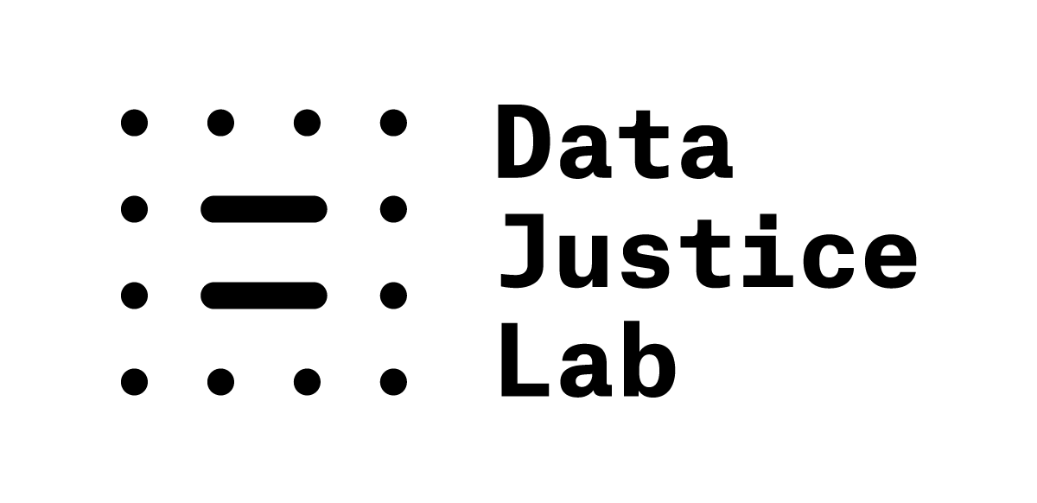
What do we do?
Public launch: March 2017
Situated within the School of Journalism, Media and Culture (JOMEC), Cardiff University, UK
Directed by Dr Lina Dencik, Dr Arne Hintz, Dr Joanna Redden
Expanding team (PhDs, post-docs, established scholars)
Projects:
DATAJUSTICE – Starting Grant from European Research Council (2018-2023)
Data Scores: Investigating uses of citizen scoring in public services – Grant from the Open Society Foundations
Data Policies: Regulatory Approaches for Data-Driven Platforms in the UK and EU (in collaboration with IT for Change) – Grant from IDRC India
Data Harms Record
Events/workshops:
First international conference on ‘data justice’ May 21/22, 2018 at Cardiff University
Critical data literacy workshops – practitioners and civil society
Critical data journalism / data justice journalism training

Slide 4


Structure of talk
Project: Digital Citizenship in Surveillance Society: UK State-Media-Citizen relations after the Snowden leaks
Project: Data Justice: Understanding datafication in relation to social justice

Slide 5
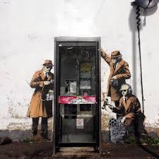
Technology
News media
Civil Society
Policy
Digital Citizenship and Surveillance Society: UK State-Media-Citizen Relations after the Snowden Leaks
Notes:
Snowden significant for understandings of digital citizenship:
From performative, active engagement with digital tools to monitored citizens
Underpinned by political economy – surveillance capitalism
Suspicionless or environmental (no trigger)
Citizens ‘participate’ themselves.
Response? Four different strands. Focus on news media and civil society.

Slide 6
Media coverage of Snowden & Surveillance
Research questions:
How have the British news media represented the Snowden leaks and digital surveillance?
How does this compare with how blogs and non-traditional media report?
What do journalists think about how to cover surveillance?
Methods:
Content analysis of press, broadcast and blog reporting
Five peak moments of coverage of Snowden leaks and surveillance
Interviews with journalists
Notes:
Media debate -> Public debate [Slide 6]
Research questions :
How have the British news media represented the Snowden leaks and digital surveillance?
How does this compare with how blogs and non-traditional media report?
What do journalists think about how to cover surveillance?
Methods:
Content analysis of press, broadcast and blog reporting
Interviews with journalists
We are not primarily interested in the substance of the revelations, but rather seek to understand the media coverage as a critical moment which crystallized key debates over surveillance relevant to digital citizenship.
We are interested in the extent to which such issues came up in debates on surveillance following the Snowden revelations.
In our content analysis, we have focused on ways of constructing debates over surveillance, looking at angles, opinions, sources and words used to discuss surveillance, amongst other things.
Interviews: With journalists covering surveillance

Slide 7
Notes:
To make our sample manageable, we used a multi-step process in narrowing down our examination of key events following the Snowden leaks.
We started by constructing a newspaper timeline with the aid of the Nexis newspaper database.
The key terms we looked for Edward Snowden, as well as the names for the two main intelligence agencies implicated in the Snowden revelations, the NSA and GCHQ.
The results of this timeline were then charted against the major events from the Snowden revelations. These events were based upon timelines and resources created by the major news organisations and outlets which covered the Snowden revelations
On that basis, we then chose the following five case studies, representing peaks in coverage that encapsulated key debates around surveillance:
The initial revelations and Edward Snowden’s unveiling as the source of the leaks.
* The interception of communications in foreign embassies and European Union offices, and spying on world leaders’ phone communications, in particular German Chancellor Angela Merkel. These two have been combined to make a more comparative sample of articles.
* The detention of journalist Glen Greenwald’s partner David Miranda at Heathrow Airport under anti-terror legislation. This raised debates around freedom of the press and national security.
* The parliamentary report into the death of Lee Rigby, including debates about Facebook and social media companies’ role in tackling terrorism.
* The Charlie Hebdo terror attacks in Paris which prompted debates about digital encryption, freedom of speech, and the resurrection of the so called ‘Snoopers’ Charter’.
Each case studies start day was the day that particular story was first published until the end of a 4 week period (28 days) in UK National Newspapers. This was done for all case studies except for Edward Snowden’s naming as the source for the leaks, where a smaller timeframe of 7 days was used.

Slide 8
Surveillance Angle
Notes:
If we look at the focus on issues around surveillance taken in the stories, the most important one here has to do with themes of terrorism, the role of security services, and UK/US government response. So, this is in stark contrast to understanding surveillance, for example in terms of debates from the perspectives of human rights, personal privacy, and freedom of the press – in other words, rights-and-citizen-based perspectives on surveillance debates.

Slide 9
Sources
Notes:
Dominance of elites: If we look at who was used as sources in these stories, we see a pattern which is quite consistent with sourcing studies of other types of media content, but one which also has significant implications for how debates around surveillance are framed: Politicians are by far the most dominant source, followed by journalists and the media. In this sense, political sources are framing the debate and how it is interpreted. This has significant consequences, in turn, for which opinions and perspective are most salient.

Slide 10
Expressions of Opinions by Sources
Notes:
We also coded for what the main opinions from sources were on surveillance. This graph shows opinions that appeared 6 times or more. The pattern that we get from our five case studies is a very interesting one: What we see here is that the most frequent opinion was that surveillance should be increased/is acceptable/necessary, followed by The Snowden Leaks have Comprised the work of the intelligence services and social media companies should do more to fight terror, (as Facebook was faulted in the Lee Rigby case to not sufficiently monitor its users and their activities). So this dominant framework understands surveillance as a valuable activity and one for which both intelligence services and businesses have a responsibility – rather than as primarily problematic for citizens. This is a circumvention of more frequent debates on the ways in which, for example, Facebook’s use of our data might violate the privacy of its users. So we see here a focus on responsibility and action, rather than the repercussions and implications of these activities for citizens and society.
For example, in the snooping on world leaders case study, the most common opinion here was that surveillance (in the form of snooping) is damaging to international relations –framing surveillance as something that is primarily of relevance to big players, rather than ordinary citizens, and something that is problematic for macro-political reasons, rather than in terms of individual rights.
Comparing opinions in the five studies also highlights the overall pattern that opinions surrounding individual liberties were not foregrounded in the coverage, and thus not presented as a significant concern.

Slide 11
Media coverage of Snowden & Surveillance
Focus on terrorism and role of security services, not on human rights and privacy
Sources: predominantly politicians
Debates around surveillance are framed by elites rather than citizens
Media contributed to the normalization and justification of surveillance
The consequences and extent of mass surveillance for citizens are largely invisible
Journalists are critical about surveillance and reporting, worried about chilling effect on press freedom
Blogs, specialist and alternative media have critical coverage
Notes:
Results [Slide 7]:
The focus taken in the coverage has been on themes of terrorism and the role of security services, not on human rights and privacy, and not on rights-and-citizen-based perspectives on surveillance.
The sources in stories are predominantly politicians, which means that debates around surveillance are framed by elites rather than citizens.
Media has therefore led to the normalization and justification of surveillance. The consequences and extent of mass surveillance for citizens are largely invisible in media coverage.
Interestingly, journalists themselves are critical about surveillance and the reporting of it.
Blogs, specialist and alternative media had a far more critical coverage.

Slide 12
Civil society: Public knowledge and activism
Research questions:
What is the level of public knowledge and attitudes to digital surveillance?
What is the impact of the Snowden leaks on activism and advocacy?
Methods:
Focus groups with British public (52 participants across 10 focus groups of 3-8 people; demographic diversity across gender, age, ethnic background, income, location)
Interviews with activists and campaigners (11 organisations across labour, anti-war, civil liberties, environment, community, anti-austerity)
Notes:
Research questions:
What is the level of public knowledge and attitudes to digital surveillance ?
What is the impact of the Snowden leaks on activism and advocacy ?
Methods:
Focus groups with British public
Interviews with activists and campaigners

Slide 13
General public
Attitudes:
Limited knowledge of Snowden
(Meta)data collection is surveillance
Concerns about lack of transparency, lack of control, how to opt out
Response:
Self-regulation (pragmatism, not encryption)
Resignation, rather than consent
‘Sociology of digital resignation’ (Draper and Turow), ‘Surveillance Realism’ (Dencik)
Notes:
Confusion about Snowden/Assange/Manning
Note – difficult to distinguish who is carrying out the surveillance

Slide 14
Political activists
Lack of knowledge and ‘surveillance realism’
History of police infiltration
Dependency on tools for organising and mobilising
Online behaviour not linked to Snowden
Using encryption = lack of transparency
Only for ‘radical’ politics ➔ surveillance ‘keeps the mainstream in check’
‘Chilling effect’
Outsourcing of anti-surveillance resistance
‘Disconnect’ in civil society (technology vs. social justice)
Notes:
This extends to political activists although more critical
Digital surveillance less salient than police infiltration
Snowden not transformative
Miriam Aorough/Seda Guerses identify similar disconnect, looking at tech activists
This is very significant.

Slide 15
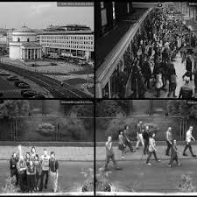

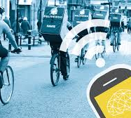
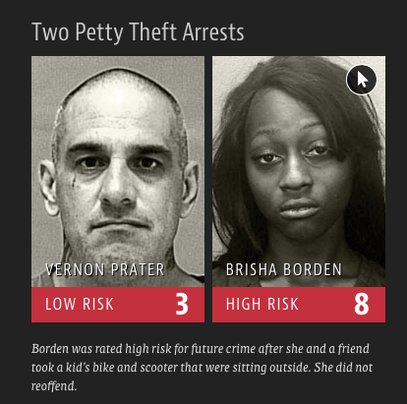


The datafied society….
Refugee or Terrorist? IBM Thinks Its Software Has the Answer. Defense One
When your boss is an algorithm. Financial Times
Can an algorithm hurt? Polish experiences of profiling the unemployed. CIHR
Machine Bias: There’s software used across the country to predict future criminals. Propublica
New Zealand experts warn Australia data-driven welfare ‘abuses and brutalises’. The Guardian
What happens when an algorithm cuts your health care. The Verge
Notes:
We are beginning to understand how these systems are being developed, often by private actors, and incorporated across different sectors and organizations. Government departments and state agencies, in many countries, now rely on the mass collection of data on people to inform not only security measures, but to device policy in areas such as education, benefits allocation, child welfare and social housing (Redden, 2017).
Eubanks (2018) has outlined the rise of a ‘regime of data analytics’ in public services, detailing uses of automated welfare eligibility systems, the development of an electronic registry of the unhoused, and the use of predictive risk models in child protective services. More widely discussed, we are seeing extended uses of predictive analytics in identifying criminality, including the emergence of data-driven scoring in criminal justice systems, where risk assessment tools are used to produce ‘risk scores’ on defendants to estimate their likelihood of committing future crimes (Angwin et al., 2016). In border control, data-driven profiling based on a cross-set of aggregated data is increasingly used for ‘vetting’ the ‘threat’ of migrants and refugees to society, producing what some refer to as a ‘terrorist credit score’ (Crawford, 2016).

Slide 16
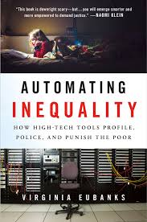
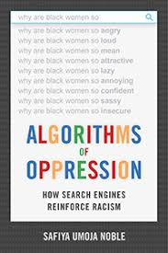

What is at stake?
Dominant framing: efficiency / security vs. individual privacy and data protection
Emerging issues:
Data processes advance prediction and preemption
Data processes are uneven (social sorting)
Data processes are premised on power asymmetry (data profilers vs. data subjects)
Data processes can discriminate and exclude
Notes:
These developments raise important questions for how we are to understand what is at stake with big data surveillance.
What we saw in the post-Snowden debate was a particularly narrow frame.
These types of developments challenge the ways in which big data and datafication has predominantly been framed. In the immediate aftermath of the Snowden leaks, the framing of the debate has predominantly been around a drive towards greater security. This has been accompanied by a big data discourse around efficiency (mention Joanna’s research with government departments) on the one hand and a concern with individual privacy and the protection of personal data on the other.
But we are beginning to realize that this is too limited a way to understand what is actually at stake with datafication because it assumes that the transformation is merely technical and that we are all equally implicated in these processes equally.
CLICK
Partly, as Lyon (2015) suggests, data-driven decision-making is a continuation of the bureaucratization that has been long-standing in public administration. But used in conjunction with an onus on anticipation, it also seeks to place more weight on managing consequences rather than seeking to understand underlying causes of social ills – the focus is on the ‘what’ and not the ‘why’. Indeed, for Andrejevic (2017) the shift is one from prevention to preemption that advances a spatial-temporal configuration that significantly undermines how we have previously understood the democratic process. That is, it comes to include the ‘rapid shrinking of the space and time for deliberation – a diminution heralded by automated forms of sorting, decision making, and response that promise (or threaten) eventually to subtract the human element altogether’ (p. 879). Calculative and indeterminable, with preemption the future collapses into the present. Insofar as politics is a site of both struggle and deliberation, the data-driven decision-making that sustains the current operative logic of preemption comes to appear as decidedly ‘postpolitical’ (Andrejevic, 2017).
But also key question for citizenship – governed on basis of what we might do, not who we are.
Datafication and data-driven surveillance relies on practices of categorization, classification, characterization, segmentation, selection, scoring, and exclusion, using remote searchable computer databases that are ‘capable of integrating any number of other systems into itself’, being connected to other databases, and allow ‘for the production of data, not simply its organization and retrieval’ (Wilse, 2008, pp. 234-5). In this context, Lyon (2015) describes the system emerging as one predominantly of ‘social sorting’, drawing also on Gandy’s (1993) conception of the ‘panoptic sort.’ The focus here is on the processes by which the collection of data on and about individuals and groups as ‘citizens, employees and consumers’ is used to identify, classify, assess, sort, or otherwise ‘control the access to the goods and services that define life in modern capitalist society.’ (Gandy, 1993 p. 15) At its foundation, the panoptic sort privileges some, while disadvantaging others.
Eubanks – unevenness – we don’t all have the same experiences of the datafied society.
Similarly, Vagle (2016) argues that the ‘structural surveillance’ that permeates the datafied society leads to social ordering whose effects can be very real, limiting economic and spatial mobility, social and political opportunities and civic engagement. At the same time, such data-driven social sorting is marked by entrenched opacity, or what Vagle (2016) refers to as ‘meta-invisibility.’ This asymmetry is inherent to the datafied society and underpins relations of power. As Ansorge (2016) has argued, digital power creates a space for political activities away from the public eye, within the internal, bureaucratic identifying and sorting processes. Those engaging in such processes are liberated from the identity constructions of the people they are identifying and sorting. ‘When this occurs’, Ansorge (2016 p. 10) contends, ‘digital power affords an experience of extreme legibility to those looking at computer screens – watching the flow of images and strands of data in the matrix – while those subject to the sorting and identifying experience are alienated from their representations.’ What we are faced with, therefore, is ‘a profound inequality of legibility.’
Such alienation is particularly pressing as the logics of ‘disembodied control at a distance’, which Monahan (2008) argues marks modern surveillance systems, artificially abstract bodies, identities, and interactions from social contexts in ways that both obscure and aggravate social inequalities. Indeed, whilst it is often argued that the collection and use of large amounts of data can provide possibilities for more informed decision-making, an emerging body of research has also warned that datafication may harm particular communities in different ways.
Of prominent concern have been the ways in which data systems produce discriminatory outcomes by using skewed data-sets that will often incorporate historical bias into the decision-making (Crawford, 2013) or through algorithmic bias that produces outcomes based on unfairly weighted variables and categories (Bozdag, 2013). Others have drawn attention to the ways in which data systems allow for the possibility of discrimination through inferred information (Croll, 2012) and uses of ‘proxy’ categories for sensitive data on ethnicity or social status. More generally, it has been highlighted how decontextualized data (boyd and Crawford, 2012) that is repurposed, combined and aggregated to provide correlations can reinforce existing discriminatory or exclusionary practices, precisely by the alienating practices of digital representationalism. The issue is not that harms are necessarily intentionally programmed into data-driven systems, but that the development, design, and uses of algorithmic processes across social life are embedded in certain historical and institutional contexts, values and agendas that shape the multiple and differential ways in which citizens are implicated in them. At the same time, these contexts, values and agendas are obscured by the firm belief in the representational capacity of data. In this we see clearly how notions of ‘objectivity’ and ‘neutrality’ as central features of the datafication paradigm appear as ‘carefully crafted fictions’ (Kitchin, 2014); myths that risk depoliticizing what remain deeply political decisions.
In other words, these developments become a fundamental question of social justice.

Slide 17
Focus of ‘data politics’ and social justice
Automation of social knowledge (meta-values, rationality, ideology)
Democracy (transparency, accountability, due process)
Political economy (corporate power, political agenda)
Identity and lived experiences (‘distance’, ‘else’)
Social and economic rights (dislocation, alienation)
Notes:
So what should be our focus when we are talking about data in relation to social justice. Evelyn Ruppert and others have advanced ‘data politics’ as a field that engages with the performative power of or in data that includes a concern with how data is generative of new forms of power relations and politics at different and interconnected scales. We see this play out in different debates:
So at a kind of meta-level, questions of come justice come to have pertinence in discussions on the implications of what happens when what counts as social knowledge is increasingly algorithmically processed (so how we are to understand social life, activities, behavior, social problems) – if theories of justice rely on our capability to reason, then how do such developments shape such capability, what comes to count as reasonable when we are to understand the social world on such terms. And of course, as highlighted by critical data studies, what are the ideological dimensions of this rationality?
At another level struggles for justice play out in what datafication means for the democratic process – black box, responsibility etc.
Linked to that, how do power relations shift and interests advance? Corporate power, political agenda (responsibilisation)
Different level – a (new) politics emerges in the ‘productions of life’ (Cheney-Lippold, 2017) that come from codified interpretations of social relations. Data systems produce ‘measurable types’ such as ‘at risk’ that are ‘actionable analytical constructs of classificatory meaning, based exclusively on what is available to measure.’ (Cheney-Lippold, 2017, p. 24) As these come to underpin governance and decision-making, this ‘algocracy’ (Danaher, 2016), or rule by algorithm, creates a struggle for what Cheney-Lippold refers to as all the ‘else’ of lived experiences, the complexities and unquantifiable dimensions of social life and personal identities. The politics of data, in this sense, emerges in what we might think of as the ‘distance’ (Goriunova, 2016) between a citizen and its constructed data subject, the human and the digital. This struggle is akin to the one outlined by Terranova (2004) between macrostates and microstates in her concept of ‘dividuals’ in which the categories of identity that we normally think of as politically owned by us, like gender, race, and citizenship (‘macrostates’) become nonlinearly connected to an endless array of algorithmic meaning, like web use and behavior data (‘microstates’).
This also extends to the dislocation between the categorizations of social life constructed by algorithmic process and those we have in place for the protection of social and economic rights.

Slide 18
Approaches to ‘data justice’
Principles (e.g. (in)visibility, anti-discrimination, (non-)engagement)
Technology (e.g. fairness-by-design)
Integrated social justice agenda
Data justice – beyond techno-legal solutionism
Data as a social and economic justice issue
Systemic critique – alternative imaginations on the organisation of society
Practical implications:
Collective (beyond individual acts)
Broaden framework and stakeholders
Perspective (from margins)
Notes:
So what does this mean for how we are to understand ‘data justice’?
For some this means a focus on principles – e.g. Taylor
Or a focus on technology – identifying discrimination and fixing algorithms
My own approach comes at it a little differently – link back to previous research on civil society.
What does data mean, or how does data fit, within different social justice agendas?
By taking this approach, the point is to understand how data fits in long historical struggles against forms of oppression and exploitation, and to actively link concerns with technology to economic and social justice concerns as a way of mobilizing a broad movement around developments in datafication.
We need to understand how these systems work – you can help us!

